Slide 1

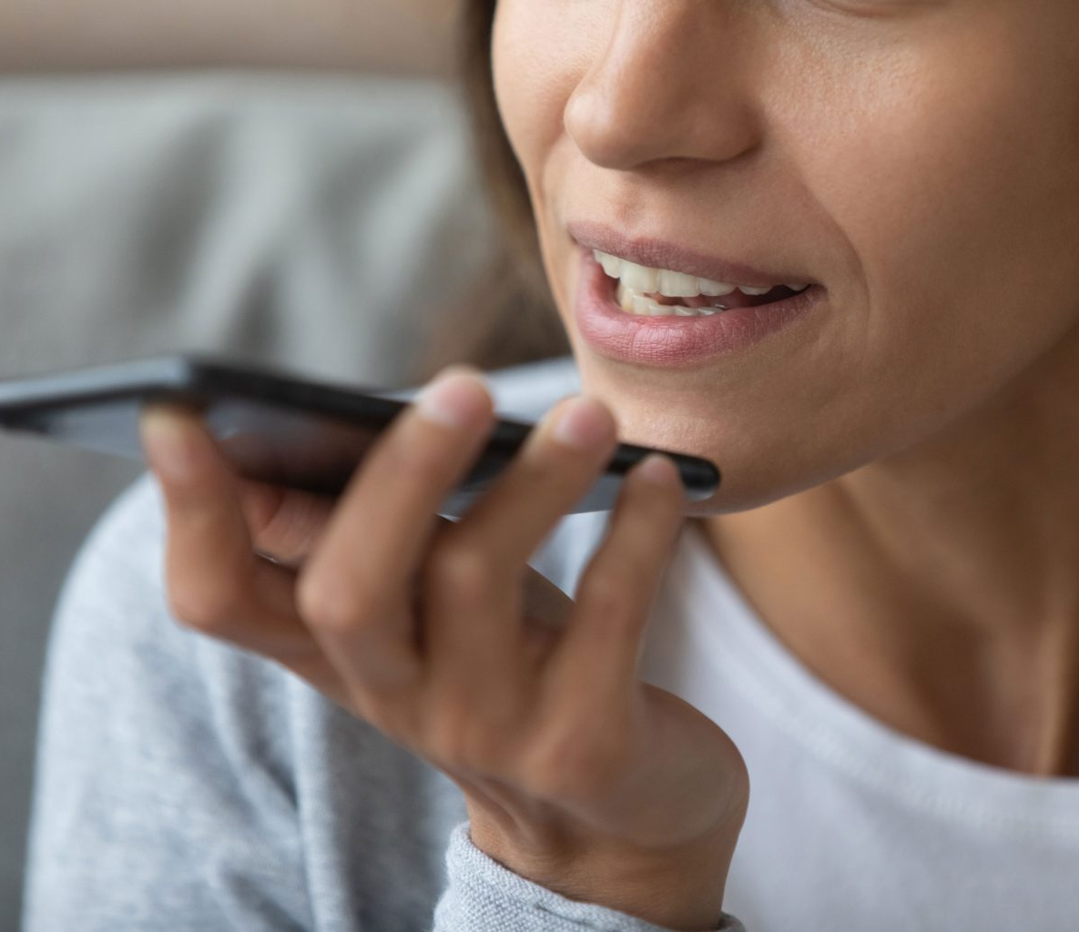
Ingenious
Voice
Biometrics
Solution for SBI Innovate 2022
Team Name: Ingenious
Members: Shivani Tyagi
Divya Gupta

Slide 2

FLOW OF PRESENTATION
What we’ve tried to build
High-level Design
Tools & Technologies
Algorithms
GUI Screenshots
Demonstration
Test cases
Why our solution?

Slide 3
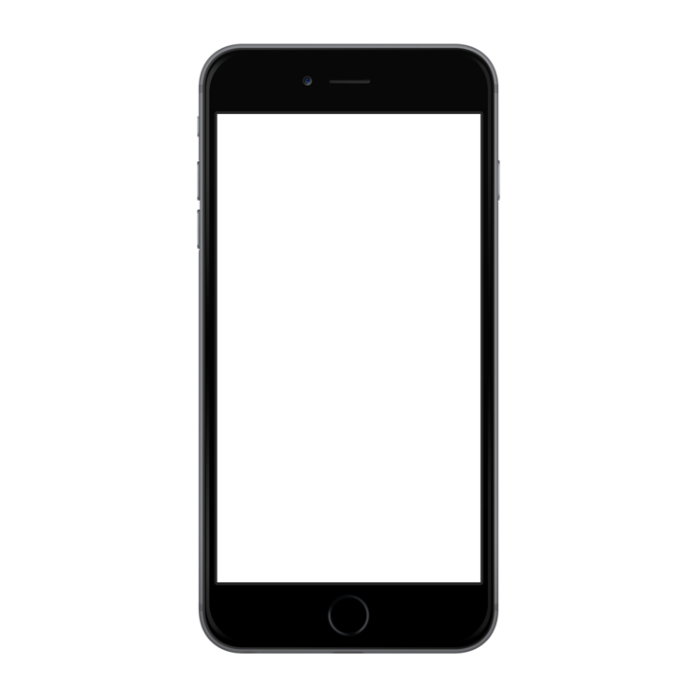
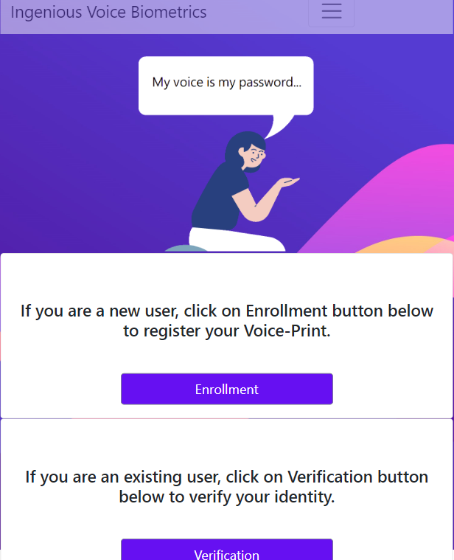
What we have tried to build
We have tried to build an easy to use API for authenticating voice of customers from different applications such as Contact Centers, Chat-bots, Mobile/ Web Applications.
The application takes the Customer’s voice as input
Processing is done to enhance the quality of audio sample collected
Now, the enhanced voice sample is used to create a “Voice-Print” of the customer
Next time, the user interacts with their voice, their “Voice-Print” can be used to authenticate the user

Slide 4

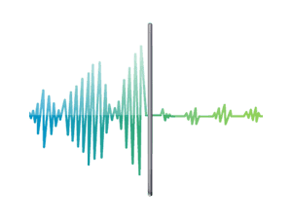


HIGH-LEVEL IMPLEMENTATION DESIGN
Enrollment Phase
During Enrollment, user will be asked for choose a User ID along and upload 3 voice WAV files
MFCC
GMM model
3 audio WAV files
are uploaded by user
Audio files are pre-processed.
MFCC features with combination of Delta are extracted
GMM model of user is generated
Model is stored as pickle file
Pickle file is stored on Azure storage

Slide 5

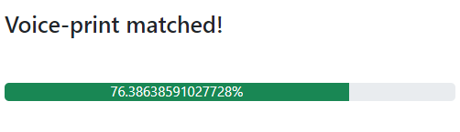

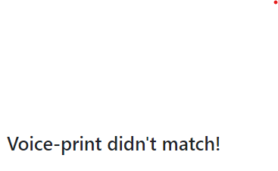
HIGH-LEVEL IMPLEMENTATION DESIGN
Verification Phase
During verification, user will be asked for user ID along with the audio WAV file. The features extracted will be compared with the GMM models of enrolled users and on finding the match , score is displayed.
MFCC
WAV file
user
MFCC features with combination of Delta are extracted
Audio files are pre-processed.
[gmm1, gmm2…….gmm(n)]
Unpickling the models and creating list
Pickle files of enrolled users are extracted from Azure Storage
Matched

Slide 6


TOOLS & TECHNOLOGIES
Programming language: Python
Framework: Flask for creating REST API
Storage: Azure Blob Service
Python libraries used:
Flask==2.1.2
numpy==1.22.4
pydub==0.25.1
python_speech_features==0.6
scikit_learn==1.1.1
scipy==1.8.0
torch==1.11.0
PySoundFile==0.9.0
+
+

Slide 7
ALGORITHMS
Feature Extraction: MFCC + Delta MFCC
Model: Gaussian Mixture Model (GMM)
Score Metric: Log-likelihood

Slide 8

User Interface

Slide 9
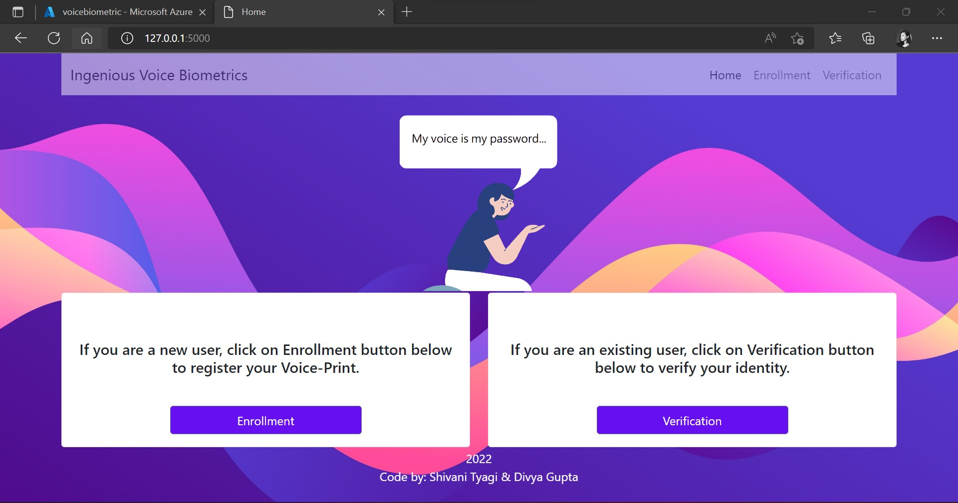
1. Home Screen

Slide 10
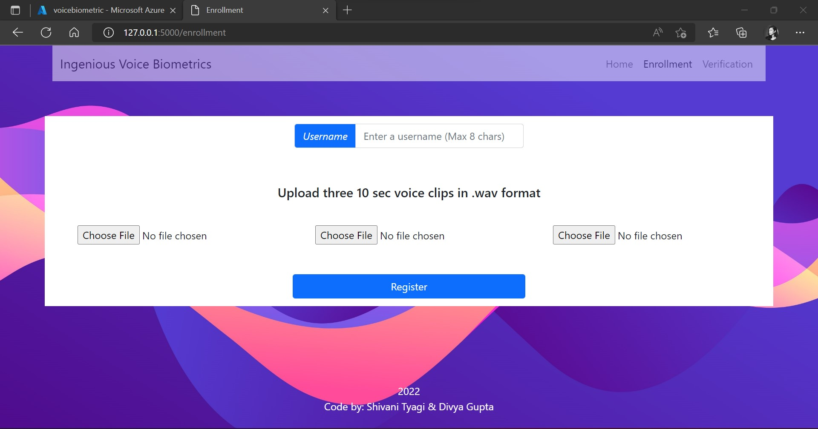
2. Enrollment Screen

Slide 11

3. Verification Screen

Slide 12
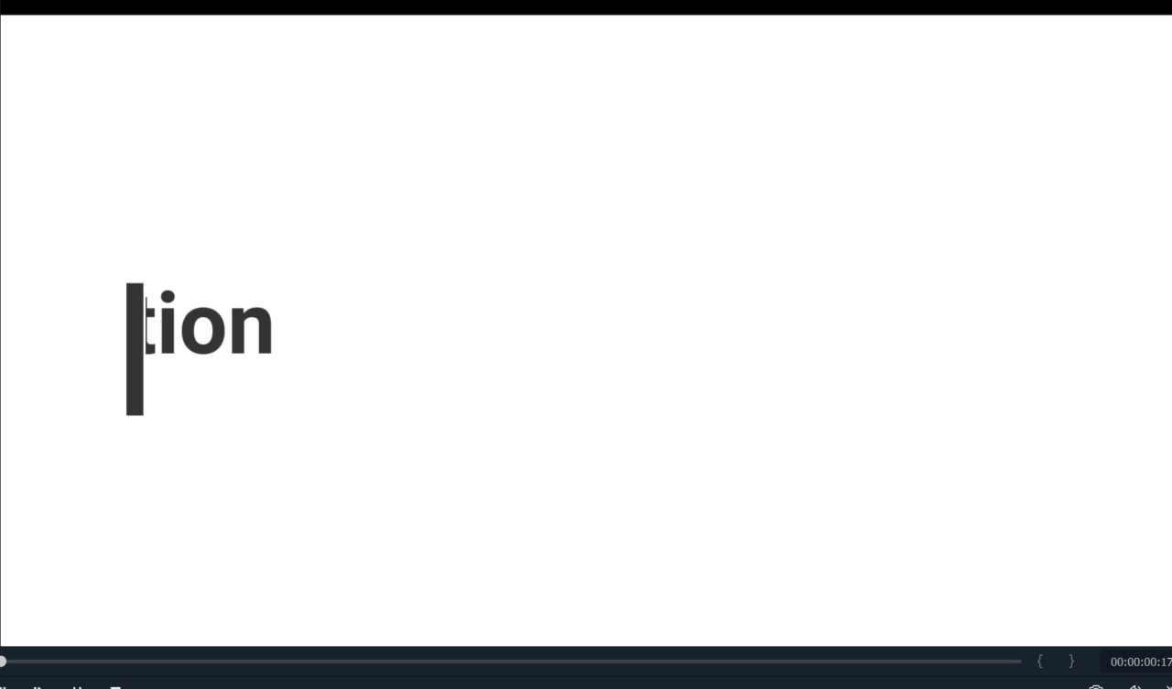
Demonstration

Slide 13
TEST-CASES
Test Case No. | Test Function | Test Outline | Output
1 | Enrollment | User “A” enrolls (as a new user) | Status: Success
2 | Enrollment | User “A” enrolls (already existing) | Status: Failure Desc: Existing user
3 | Verification | User “A” tries to do verification | Status: Success Score: 79
5 | Verification | User “B” does not exist and tries to do verification. | Status: Failure Desc: User doesn’t exist
6 | Verification | User “B” tries to do verification for user “A” | Status: Failure Desc: Voice print doesn’t match

Slide 14


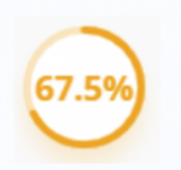

Why our solution?
Our solution has followed a text-independent approach along with language independent approach that focuses on capturing speaker’s voice characteristics instead of what is being spoken.
1
2
3
4
Language Independent
Text Independent
Confidence Score
Better Voice-print
Can be used easily by users speaking different languages
Does not bind user to speak particular words
Gives match with confidence score
Signal enhancement and modulation for better Voiceprint

Slide 15

“Those who can imagine anything, can create the impossible.”
― Alan Turing
THANK YOU

